Slide 1
Software Quality Assurance and Testing Technology
2nd Semester, Spring 2022
Haiming Liu
liuhaiming@bjtu.edu.cn
School of Software Engineering
Beijing Jiaotong University
Notes:
http://t.cn/A66iadFx

Slide 2
16 Weeks Plan
Week 1: The basic concepts and theories of testing
Week 2-3: Principles of Testing
Week 4: Testing the specification
Week 5-6: Black Box Testing
Week 7-9: White Box Testing
Week 10: Integration Testing and System Testing
Week 11: Usability Testing and Accessibility Testing
Week 12: Security Testing
Week 13: Mutation Testing
Week 14: Software Quality
Week 15: Review I
Week 16: Review II

Slide 3

Testing the specification
You do not need to have code to start testing.
Testing the specification can save on time and cost later on.
Also, mistakes in specifications account for about 55% of all bugs.
The specification is typically a written document using prose and pictures to describe the functional and non-functional aspects of the software.

Slide 4

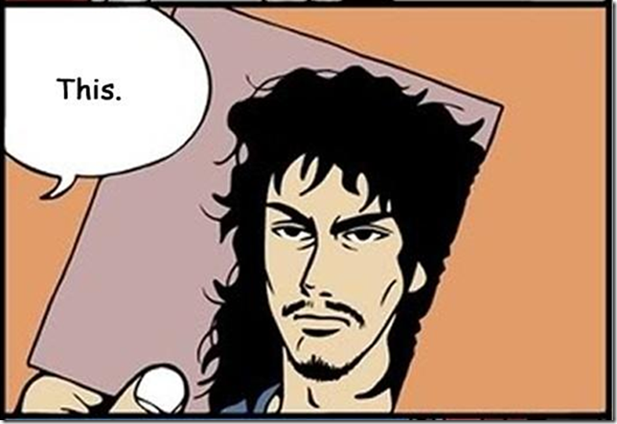

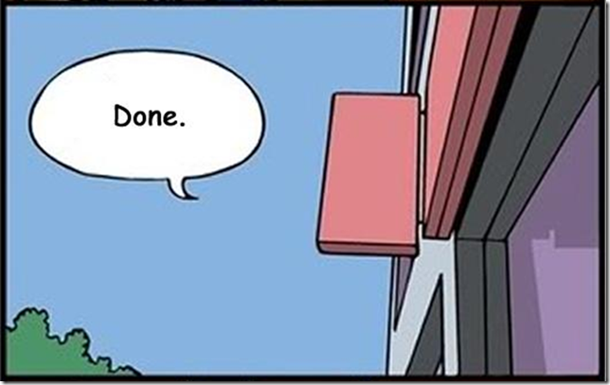
Testing the specification

Slide 5
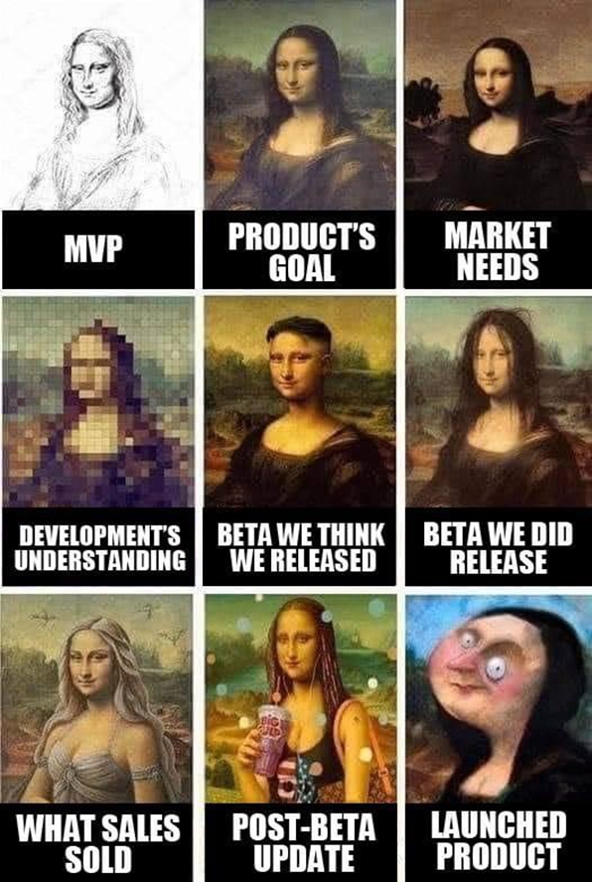
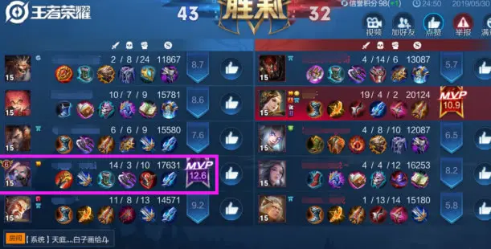
Testing the specification
minimum viable product

Slide 6

Testing the specification
An example

Slide 7

Testing the specification

Slide 8
Testing the specification
Requirements Specification: An Overview
Basic goal: To understand the problem as perceived by the user.
Activities of specification are problem oriented.
Focus on what, not how (this is design)
Don’t cloud the specification with unnecessary detail.
Don’t pre-constrain design in the specification.
After specification is done, do software design:
solution oriented
how to implement the what

Slide 9
Testing the specification
Requirements Specification: An Overview
Key to specification is good communication between customer and developers.
Work from specification document as guide.
Basically, it’s the process of determining and establishing the precise expectations of the customer about the proposed software system.

Slide 10
Testing the specification
The purpose of specification
Raw user requirements are often:
vague
contradictory
impractical or impossible to implement
overly concrete
just plain wrong
The purpose of specification is to get a usable set of requirements from which the system may be designed and implemented, with minimal “surprises”.

Slide 11
Testing the specification
The Specification document
The official statement of what is required of the system developers.
Includes system models, requirements definition, and requirements specification.
Not a design document.
States functional and non-functional requirements.
Serves as a reference document for maintenance.

Slide 12
Testing the specification
Two kinds of requirements
Functional: The precise tasks or functions the system is to perform.
e.g., details of a flight reservation system
Non-functional: Usually, a constraint of some kind on the system or its construction
e.g., expected performance and memory requirements, process model used, implementation language and platform, compatibility with other tools, deadlines, ...

Slide 13
Testing the specification
Specification document “requirements”
Should be easy to change as requirements evolve.
Must be kept up-to-date as system changes.
Foreseen problems:
“won’t support Win-3.x apps”
Expected evolution:
“will port to MacOS in next version”
Response to unexpected events/usage:
“if input data in old format, will auto-convert”

Slide 14
Testing the specification
Software Requirements Specification Structure
Introduction (describe need for system)
Functional Requirements
Non-Functional Requirements
System Evolution (describe anticipated changes)
Glossary (technical and/or new jargon)
Appendices
Index

Slide 15
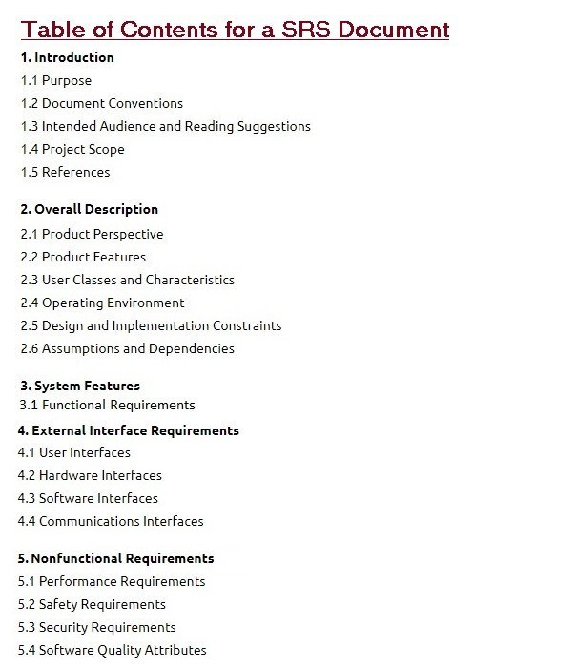
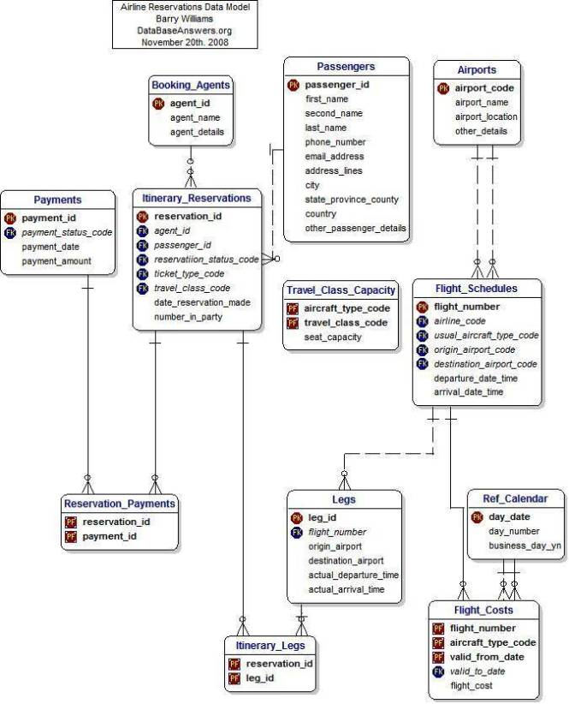
Testing the specification
Specification structure
Notes:
Software Requirements Specification

Slide 16
Testing the specification
To summarize …
Specification focuses on determining what the customer wants, and not how it will be implemented.
Specification is hard to get correct; it requires good communication skills.
Requirements may change over time.
Requirements specification requires iteration.
The customer often doesn’t have good grasp of what he wants.
Bugs created in the requirements stage are very expensive to fix later.

Slide 17
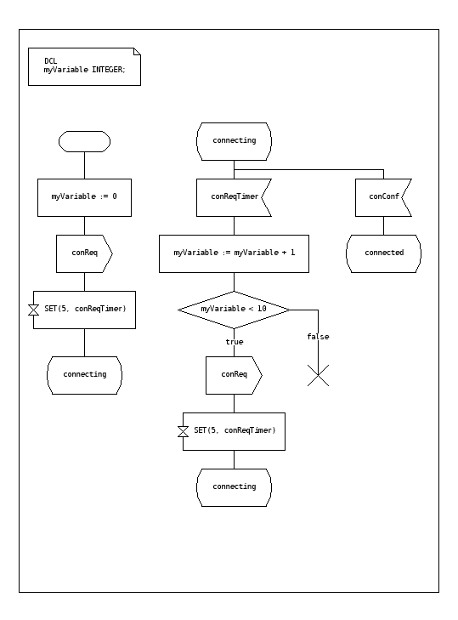
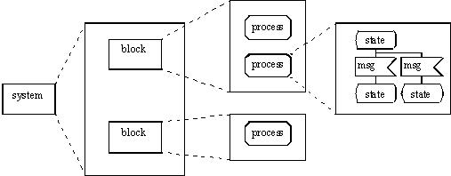
Testing the specification
Specification Languages and Tools
SDL (Specification and Description Language)
SDL is a specification language targeted at the unambiguous specification and description of the behaviour of reactive and distributed systems.

Slide 18
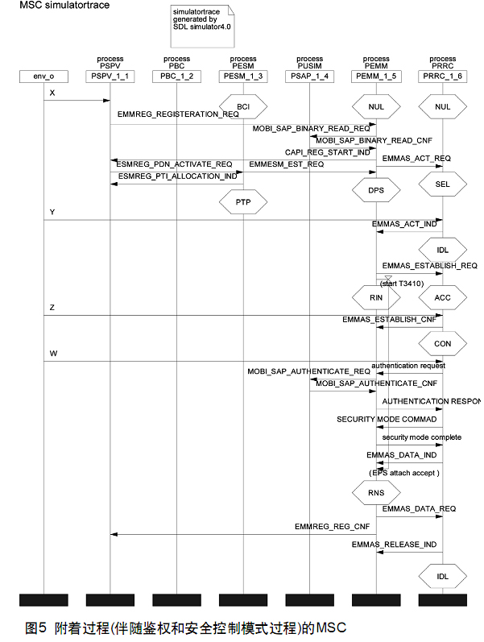
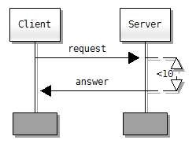
Testing the specification
Specification Languages and Tools
MSC (Message Sequence Chart)
MSC is an interaction diagram from the SDL family standardized by the International Telecommunication Union.

Slide 19
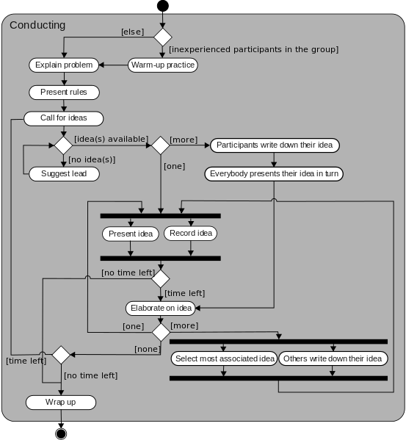
Testing the specification
Specification Languages and Tools
UML (Unified Modeling Language)
UML is a general-purpose, developmental, modeling language in the field of software engineering, that is intended to provide a standard way to visualize the design of a system.

Slide 20
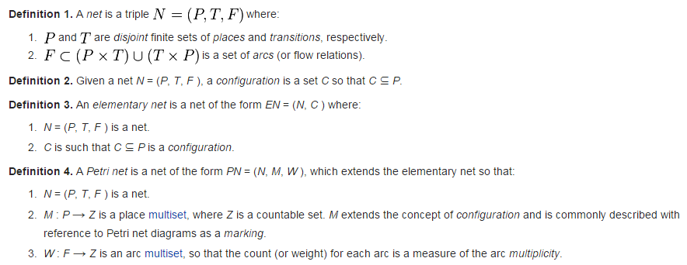
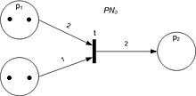
Testing the specification
Specification Languages and Tools
Petri Net
Petri Net is one of several mathematical modeling languages for the description of distributed systems.

Slide 21
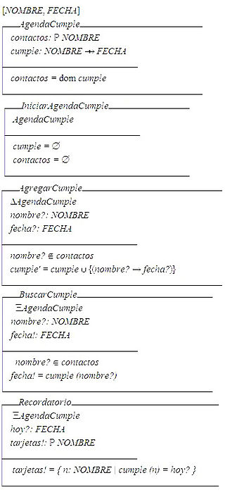
Testing the specification
Specification Languages and Tools
Z notation
Z notation is a formal specification language used for describing and modelling computing systems. It is targeted at the clear specification of computer programs and computer-based systems in general.

Slide 22
Testing the specification
Specification reviews
Involve people examining the specification with the aim of discovering anomalies and defects.
Reviewers reuse domain knowledge so they are likely to have seen the types of error that commonly arise.
Does not require the execution of a system so may be used before implementation.
Effective technique for discovering errors.

Slide 23
Testing the specification
Reviews and testing
Reviews and testing are complementary and not opposing verification techniques.
Both should be used during the V & V process.
Reviews can check conformance with a specification but not conformance with the customer’s real requirements.
Reviews cannot check non-functional characteristics such as performance, usability, etc.

Slide 24
Testing the specification
Review pre-conditions
A precise specification must be available.
Team members must be familiar with the organization standards.
Management must accept that reviews will increase costs early in the software process.
Management must not use reviews for staff appraisal.

Slide 25
Testing the specification
What is a specification review?
A process of identifying faults in the specification of a software system.
Review should uncover both errors made in producing specification documents, and errors made earlier in the requirements engineering process.

Slide 26
Testing the specification
Limitations of conventional review approaches
Too much information to go through, and not enough time to do it thoroughly.
Unfamiliarity of individual reviewers with the overall goals of the design.
No single part of the specification gets a thorough and complete evaluation.
One-on-one interaction between individual reviewers and specification team is limited.

Slide 27
Testing the specification
Better method: Active specification review process
Change from “general” review to a set of more focused reviews.
Use questionnaires to engage the reviewer in using the specification.
More opportunities for one-on-one discussion between reviewer and specification team.

Slide 28
Testing the specification
An example
We have been asked to review the specification for a hospital’s order processing system.
The order processing system allows users to order items for patients, such as tests or medications.

Slide 29
Testing the specification
Active specification review process Step 1: Prepare the specification for review
Think about what criteria reviewers will use:
Well-structured
Simple
Adequate
Flexible
Practical
Easy to implement
Standardized

Slide 30
Testing the specification
Active specification review process Step 2: Prepare the documentation for review
Make assumptions explicit
System can record the order pertaining to a patient.
It is possible to obtain all the orders for a patient.
System can determine and change the status of an order.
The order always contains at least one item.
The status of an order is always in one of the two states i.e active or cancelled.
Incorrect Usage Assumptions
Cannot add or remove items once the order is placed.
Once an order is cancelled, the status cannot be set to active again.
An item is always added with respect to an order.

Slide 31
Testing the specification
Active specification review process Step 3: Identify the specialized reviews
Focus the reviewer’s attention on specific properties of the specification (e.g., data access).
Data access sufficiency.
E.g., provides all data required by the other features of the system.
Assumption Sufficiency.
E.g., contains all of the assumptions needed to access the feature’s data.

Slide 32
Testing the specification
Active specification review process Step 4: Identify the reviewers needed
People with different perspectives and expertise are needed as reviewers
Programmers and analysts who worked on the other features of the order processing system.
Programmers and analysts familiar with hospital information systems in general.

Slide 33
Testing the specification
Active specification review process Step 5: Design the questionnaires
Make reviewers take an active role
Make reviewers use the documentation
Phrase questions in an active way
E.g., “Write down the exceptions that can occur” rather than “Are exceptions defined for every program?”

Slide 34
Testing the specification
Active Specification Review Process Step 6: Conduct the review
Present an overview of the specification.
Assign reviews to the reviewers.
Reviewers complete their reviews, meeting with the specification authors as needed.
Specification authors review completed questionnaires, and meet with reviewers to resolve questions.
Specification authors produce new version of the specification.

Slide 35
Testing the specification
Specification attribute checklist
Completeness
Accuracy
Precision
Consistency
Relevance
Feasibility
Code/Design-free
Testability

Slide 36
Testing the specification
Specification terminology checklist
Always, every, all, none, never, … (absolutely sure?)
Certainly, therefore, clearly, obviously, customarily, most, … (persuasion lingo)
Some, sometimes, often, usually, ordinarily, customarily, most, … (vague)
Etc., and so forth, and so on, such as, … (not testable)
Good, fast, cheap, efficient, small, stable, … (unquantifiable)
Handled, processed, rejected, skipped, eliminated, …
If … then … (missing else)

Slide 37
Testing the specification
Conclusions
Reviewers focus on those areas they are best suited to evaluate
Time is used more wisely for all participants
More errors are likely to be found
One-on-one communication with specification authors makes it easier for people to speak up.
Few errors found does not necessarily indicate that the specification is good.
E.g., Perhaps the review process was not effective.

Slide 38
Testing the specification
You now know …
… what a specification is
… how to review (test) a specification
… the benefits of an “active” specification review process

Slide 39
To be continued… See you next week

